Slide 1


Slide 2
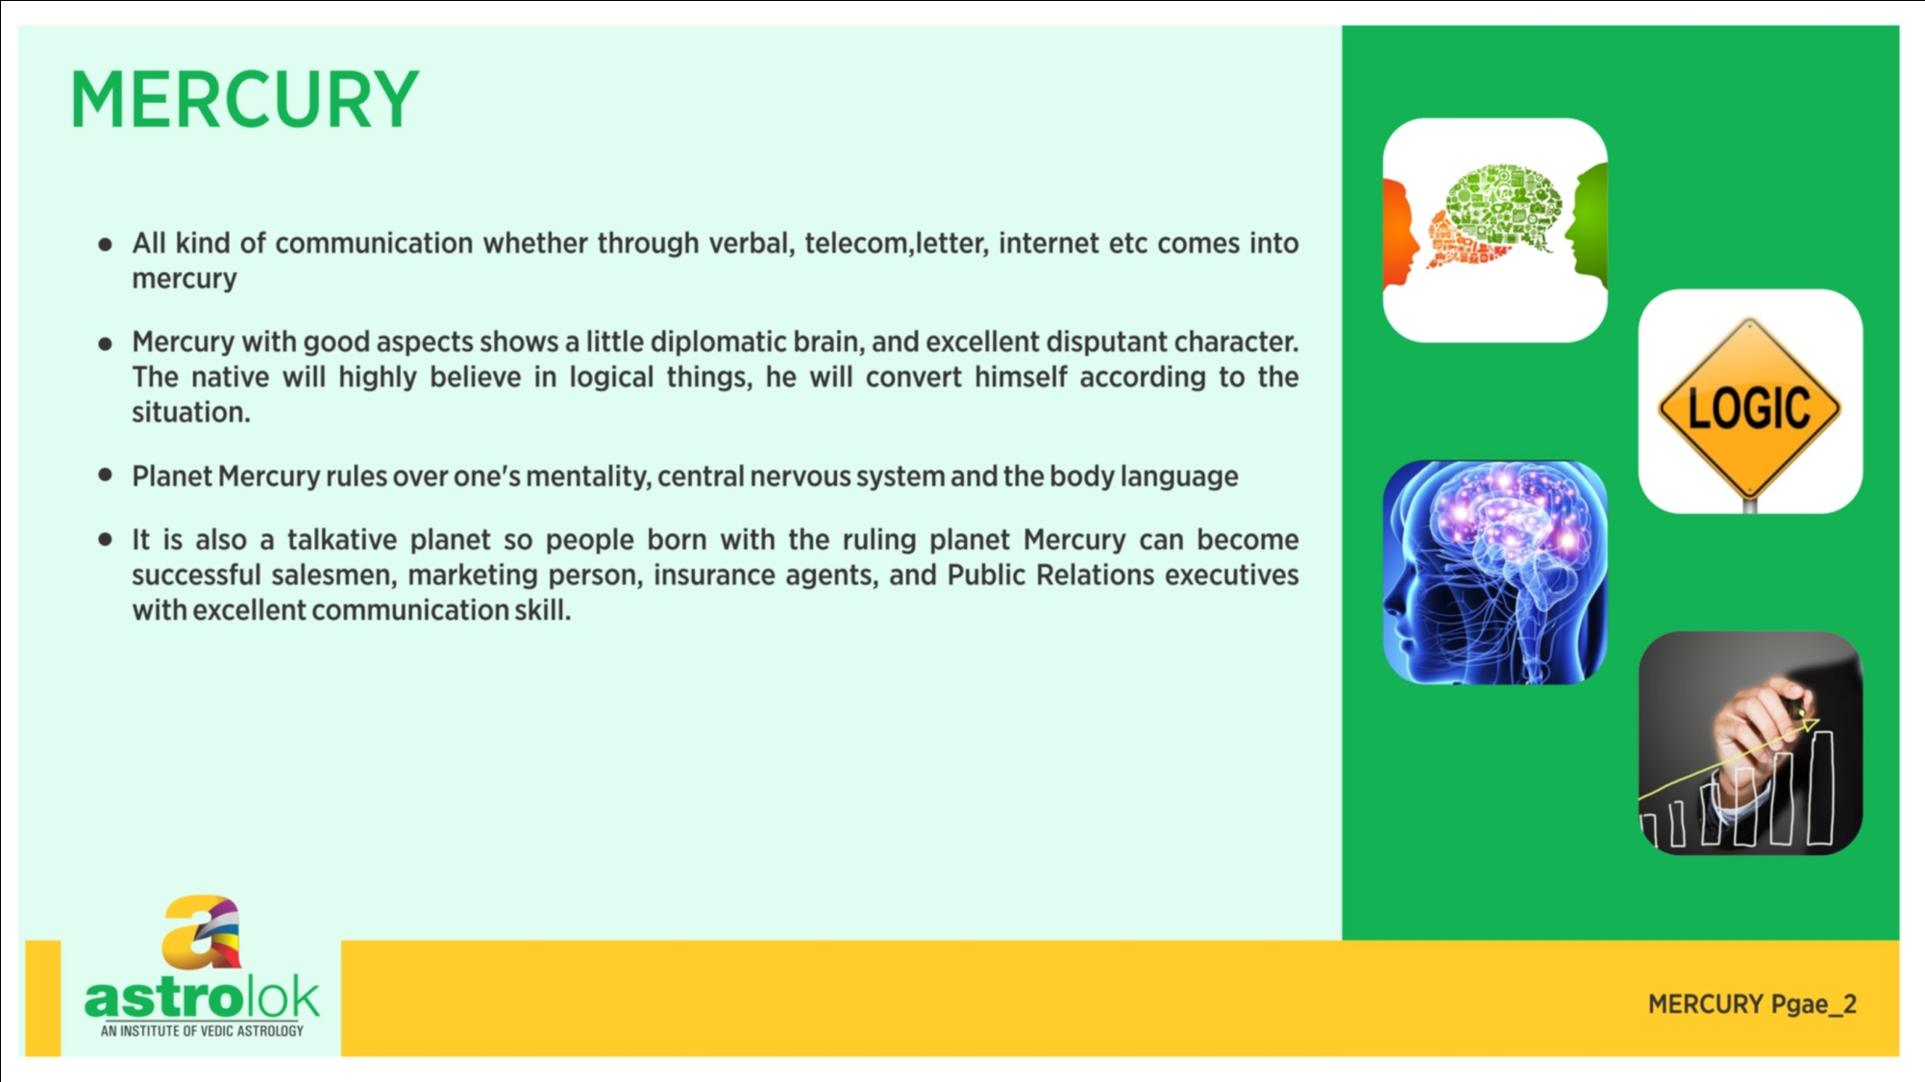

Slide 3
mercury IN DIFFERENT HOUSES mercury in 1st house
Mercury in the lagna(Ascendant) makes the person very intelligent and gives him a great sense of humor
Mercury if in own rashi or exalted makes a great rajyoga here which makes the native very intelligent, great mathematician
Mercury being a benefic planets in the lagna gives prosperity and fame to the native
If this mercury if afflicted then the person has multiple thoughts and changes his mind very soon.
Afflicted mercury in the 1st house makes the person characterless and if it is with Rahu gives depression also.

Slide 4
mercury IN DIFFERENT HOUSES mercury in 2nd house
Mercury in the 2nd house makes the person intelligent and gives good education
The person is born in a rich family and gets good initial education
Mercury in the second house makes the person very diplomatic in speech, if afflicted then the natives becomes liar, if with ketu it makes the person hesitant to speak, if with rahu then the person will speak too much, if with Jupiter then very polite, with Saturn then the person is liar
Mercury being the planet of business, sitting in the house of wealth, makes the native business minded and lucky, if afflicted then the natives has a tendency to steal other’s money and do malpractice in money making.

Slide 5
mercury IN DIFFERENT HOUSES mercury in 3rd house
3rd house is the house of communication and mercury is the karaka of communication, when mercury sits in 3rd house its makes the native a very good communicator, and the natives works in the field of astrology, teaching, consultancy, mobile and communication industry.
3rd house mercury is good for publication, spiritual activities, media, advertising and communication industry
3rd house is the house of writing, all the writers, poets, journalist, orators generally has some relationship of mercury with 3rd house.
Afflicted mercury in the 3rd house makes the person a cheater, gives him a harsh speech, he gets troubles in the travel

Slide 6
mercury IN DIFFERENT HOUSES mercury in 4th house
4th house mercury gives career related to software, communication, trading etc
It makes the person very intelligent, has interest in creative activities,
The person lives in a big house and has cordial relationship with mother
Mercury in the 4 house gives properties, money and all the happiness to the native
It can lead the native to foreign land
Afflicted mercury here makes the person a cheater, characterless, interested in other women and pleasure freak. The native doesn’t focus on one job and tries to do multiple things at one time and it makes him restless.

Slide 7
mercury IN DIFFERENT HOUSES mercury in 5th house
Well educated, very intelligent, writer and a very good poet.
Mercury here in fiery sign makes the native good in math, astrology, vedic studies and dancing.
If in earthy signs it is good for learning physics, palmistry, grammer
If in the water signs it makes the natives a clerck, language expert and administrator
Mercury in the 5th house is very good for children but if afflicted in a female chart it gives abortion also.
Bad mercury in 5th house makes the native confuse and reduces the decision making powers.

Slide 8
mercury IN DIFFERENT HOUSES mercury in 6th house
If mercury is well placed it gives very good intellect and fame here but the native is of fighting nature.
Mercury here gives spiritual and divine knowledge from saints
Afflicted mercury here gives poor intellect, mental issues, skin issues, poor digestion system and diseases in genitals.
6th house mercury badly placed create obstacles in education.

Slide 9
mercury IN DIFFERENT HOUSES mercury in 7th house
Mercury although a benefic planets gives problems in marriage. It has a nature of duality and an impotent planets.
7th house mercury native generally lack potency and any relationship of mercury with 7th house gives problem in the marriage.
Since it’s a benefic planets it makes the person intelligent, and well learned, obedient, famous
The wife of the natives is from influential family, very intelligent and beautiful.
The native get worries after marriage, if badly placed it gives conflicts, divorce, multiple marriages also.

Slide 10
mercury IN DIFFERENT HOUSES mercury in 8th house
Its is the best placement for becoming an astrologer, the native is spiritual and has a command on his speech.
The native’s longevity increases, he lives a very healthy life and die peacefully
Mercury here gives parental properties and inheritance, and makes him very wealthy
Afflicted mercury makes the person crook,liar and full of sexual desires.
Afflicted mercury here decreases the age of the native and gives mental problems and disorders, skin problems at lower part of the body and pains in thighs and legs

Slide 11
mercury IN DIFFERENT HOUSES mercury in 9th house
9th house mercury makes the person super intelligent, scientist, researcher, singer, music composer and very rich
Mercury here makes the person spiritual, philosopher, astrologer.
The native becomes religious, and travel for religious purpose
It gives very good relationship with father and guru
If its badly places, the natives becomes rebellious to his religion, had a bad relationship with father and fickly minded.
The native becomes restless and tries to do multiple things at one time but doesn’t complete any.

Slide 12
mercury IN DIFFERENT HOUSES mercury in 10th house
If mercury exalted or in its own sign here forms a great rajyoga
The natives becomes famous in his profession, is very good in communication, intelligent and very close the influential people
The natives earn through communication, software or creative fields or any field where the implementation of mind is required.
The native has a very sharp memory, intelligent, famous and gives early success in life.
Badly places or afflicted mercury gives uncertainty in the career and native himself spoil his career. He becomes careless and takes wrong decision in career.

Slide 13
mercury IN DIFFERENT HOUSES mercury in 11th house
Blessed with best of qualities
Good mercury here gives many friends,and knowledge of science
The person is very intelligent, famous, prosperous, happy and generally do business
It’s a strong placement for learning scriptures and astrology
Strong mercury here fulfill all the desire of the native and he is loved by opposite sex.

Slide 14
mercury IN DIFFERENT HOUSES mercury in 12th house
It’s a bad placement for mercury, the native has a poor memory and decision making power
He uses his mind to cheat people and doesn’t obey any rules of law.
it makes the person lazy, deprived of education and humiliated.
The person travels a lot specially to foreign countries.
If aspected by benefic mercury here gives inclination towards spirituality and good sixth sense

